Slide 1


CS230-Wrapup

Slide 2
From Performance to Security: 10K Feet View
Software
ISA
Registers
ISA
Registers
Architecture
Caches, TLBs,
Branch predictors,
Prefetchers, Interconnect,
Out-of-order execution
2

Slide 3
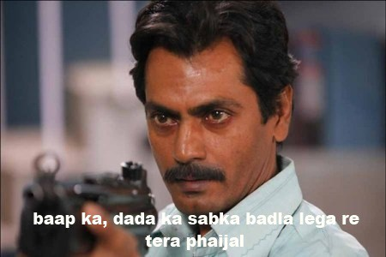
Attacker
O3 processor ka, cache ka, prefetcher ka, coherence protocol ka, DRAM ka, sabka khabar lega ☹

Slide 4
Security: A bit Subtle
Confidentiality
You do not see (READ) what you are not supposed to see
Integrity
You do not change (WRITE) what you are not supposed to see
Availability
You do not affect (DELAY) others (un)intentionally

Slide 5

Attacks Inside

Slide 6
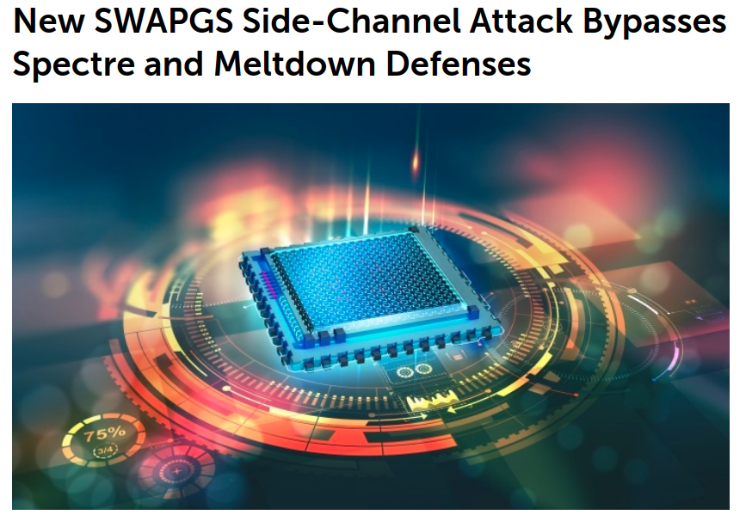
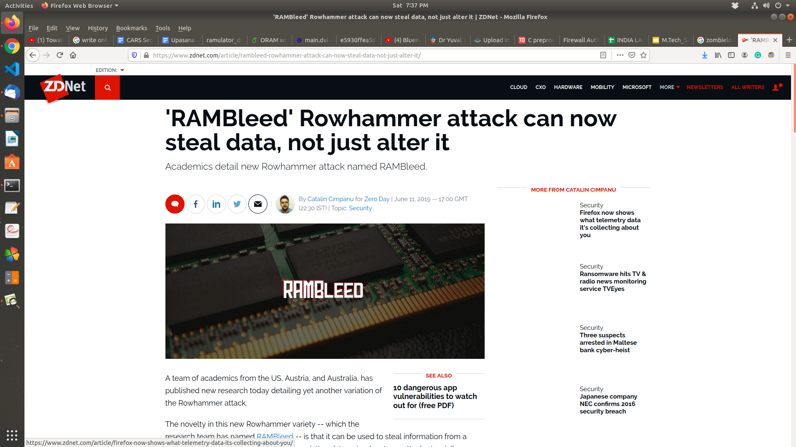
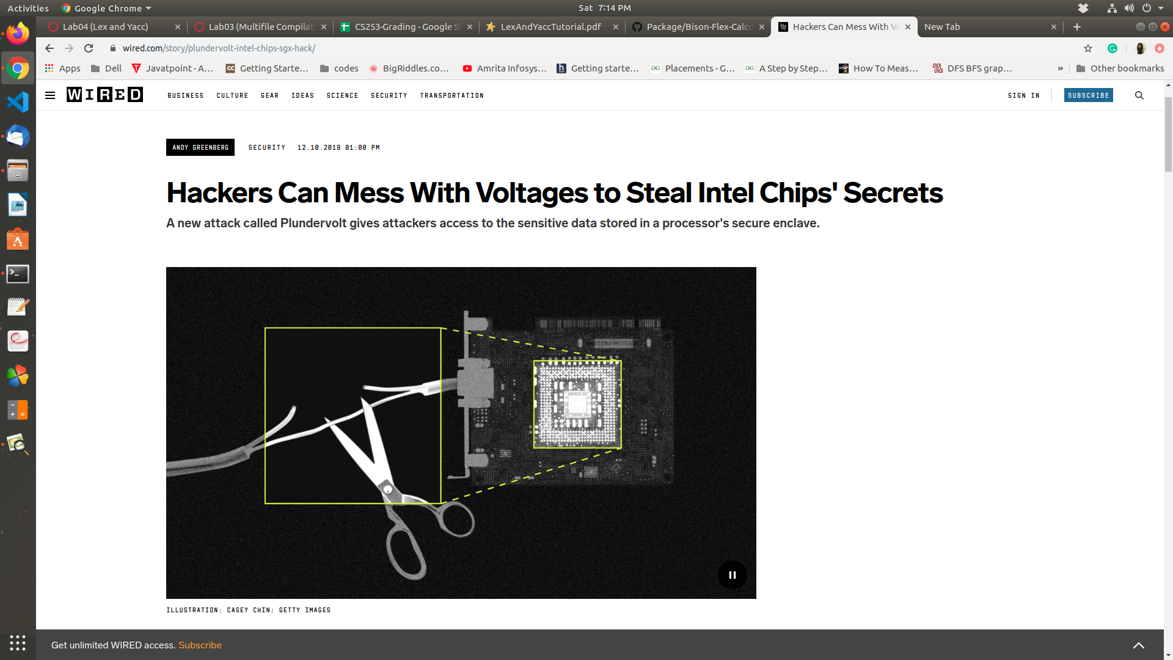


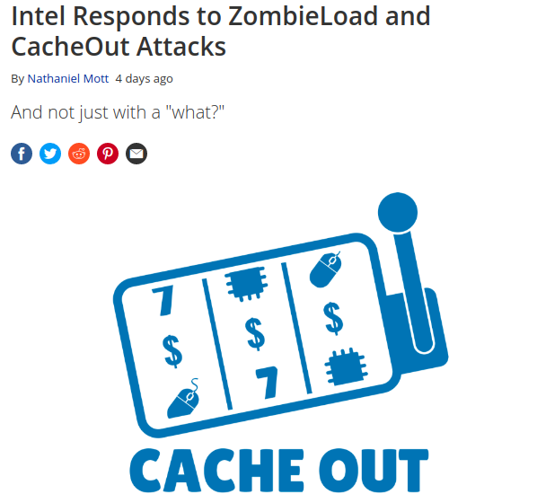





Media Articles ☹

Slide 7
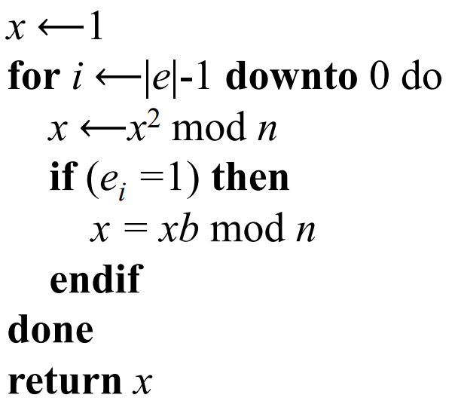
Brushing-up: Information Leakage
Modular exponentiation, b^{e} mod n
Exponent e is used for decryption
square
reduce
e_{i} = 0, Square Reduce (SR)
e_{i} = 1, SRMR
multiply
Attacker tries to get the e

Slide 8
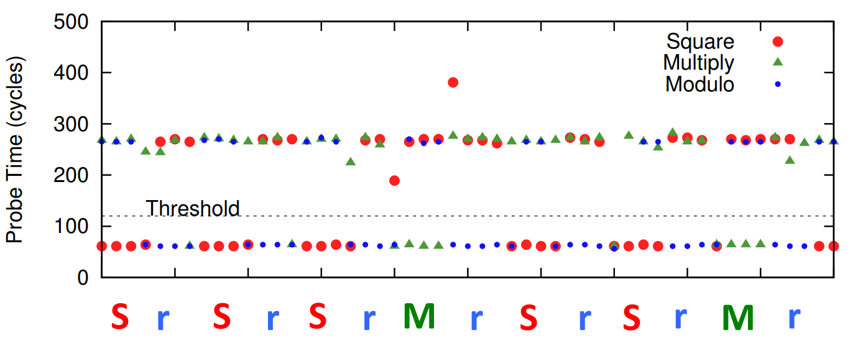
Timing Channel
Adpated from flush+reload attack [Usenix Security ‘14]

Slide 9

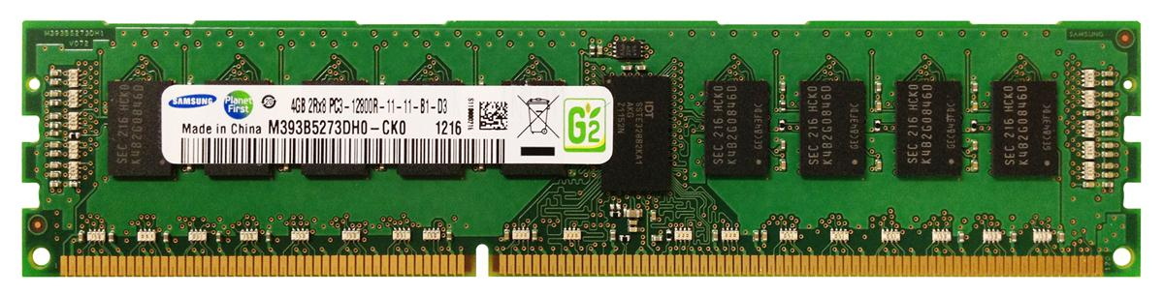

Toy Example: Flush Based Attacks
If secret=1 do
access(&a)
else // secret=0
no-access
Victim
flush(&a)
t1=start_timer
access(&a)
t2=end_timer
Attacker
Fast – 1
Slow – 0

Slide 10

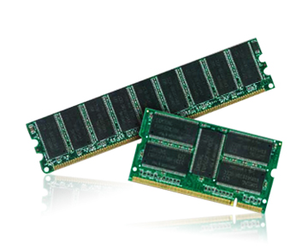

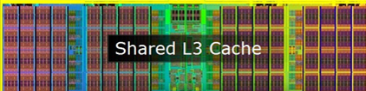
Side and Covert Channels
Spy
Victim
Side-channel attacks
Let’s play
Oh Yes!!
Covert-channel attacks

Slide 11

Pause

Slide 12


Flush+Reload Attack
Step 0:Spy maps the shared library, shared in the cache
LLC
12

Slide 13
Flush+Reload Attack
Step 0:Spy maps the shared library, shared in the cache
Step 1:Spy flushes the cache block
Clflush
LLC
13

Slide 14
Flush+Reload Attack
Step 0:Spy maps the shared library, shared in the cache
Step 1:Spy flushes the cache block
Step 2: Victim reloads the cache block
LLC
14

Slide 15
Flush+Reload Attack
Step 0:Spy maps the shared library, shared in the cache
Step 1:Spy flushes the cache block
Hit, Voila
Step 2: Victim reloads the cache block
LLC
Step 3: Spy reloads the cache block (hit/miss)

Slide 16
Pause

Slide 17
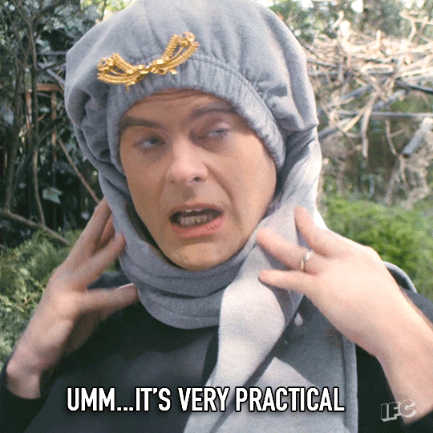
How Practical?
Future is uncertain, if we do not take care of present attacks, future may be worse ☹

Slide 18


Spectre and Meltdown

Slide 19

Spectre in Action: Fasten Your Seat Belts
int CS230Array = [100, 200, 300];
int attacker = 4;
if (attacker < sizeof(CS230Array))
y = MyArray[CS230Array[attacker]*512]
DRAM LOAD
DRAM LOAD

Slide 20

Branch Predictor and Speculative Execution
int CS230Array = [100, 200, 300];
int attacker = 4;
if (attacker < sizeof(CS230Array))
y = MyArray[CS230Array[attacker]*512]
Branch predictor returns TRUE ☹

Slide 21
Branch Predictor and Speculative Execution
int CS230Array = [100, 200, 300];
int attacker = 4;
if (attacker < sizeof(CS230Array))
y = MyArray[CS230Array[attacker]*512]
Branch predictor returns TRUE ☹
T T T T T T T T T T T
Attacker has mis-trained it ☹ ☹
How? By using values less than 3 always ☹ ☹

Slide 22
Branch Predictor and Speculative Execution
int CS230Array = [100, 200, 300];
int attacker = 4;
if (attacker < sizeof(CS230Array))
y = MyArray[CS230Array[attacker]*512]
Branch predictor returns TRUE ☹
Attacker has mis-trained it ☹ ☹
Processor is on the wrong-path ☹ ☹ ☹

Slide 23
Branch Predictor and Speculative Execution
int CS230Array = [100, 200, 300];
int attacker = 4;
if (attacker < sizeof(CS230Array))
y = MyArray[CS230Array[attacker]*512]
Branch predictor returns TRUE ☹
Attacker has mis-trained it ☹ ☹
Processor is on the wrong-path ☹ ☹ ☹
Branch resolution latency 200 cycles ☹ ☹ ☹ ☹

Slide 24
Within these 200 cycles ☺
int CS230Array = [100, 200, 300];
int attacker = 4;
if (attacker < sizeof(CS230Array))
y = MyArray[CS230Array[attacker]*512]
CS230Array[4] is in L1/L2/L3 ☹
The address is in the cache ☹ ☹
Yes, you guessed it right: F+R, P+P cache attacks ☹ ☹ ☹

Slide 25
Picture Abhi Baki Hai ☺ After 200 cycles
Processor realized it was a mistake and
flushed all wrong path instructions
But cache has the data ☹
y = MyArray[CS230Array[attacker]*512]
LOAD MyArray[0] 60 ns
LOAD MyArray[512] 60 ns
LOAD MyArray[1024] 5 ns Bingo !! CS230Array[attacker] = 2

Slide 26
Meltdown: The O3 Curse!!
raise_exception();
// line below is never reached
secret=KernelArray[data*4096];
Kernel Trap
Out-of-order (O3) as
it has no dependency
secret=KernelArray[data*4096];
2. raise_exception();
What about page-fault?

Slide 27

Summary: CS230+CS231 (Connecting the dots on the board)

